Slide 1
Drinking Etiquette
As with eating, drinking is done communally and follows some loose etiquette.
Chinese
More enthusiastic
The emphasis is on people
Drinking vessels are optional
Western
Freer
The emphasis is on alcohol
Drinking vessels are strict

Slide 2
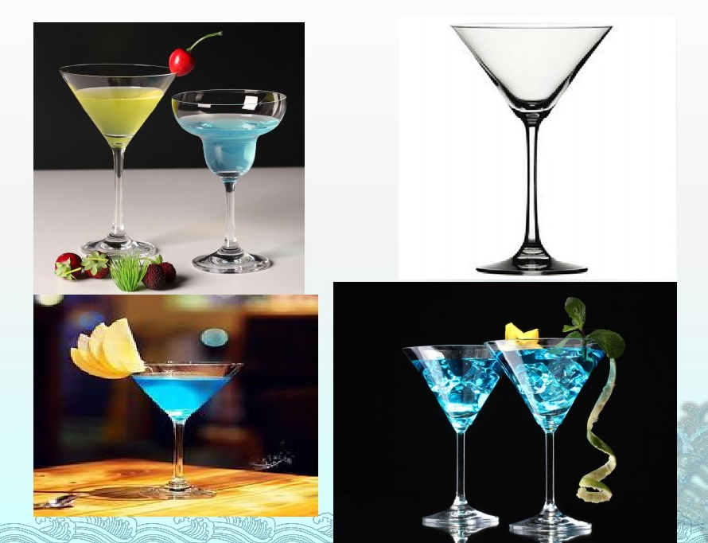
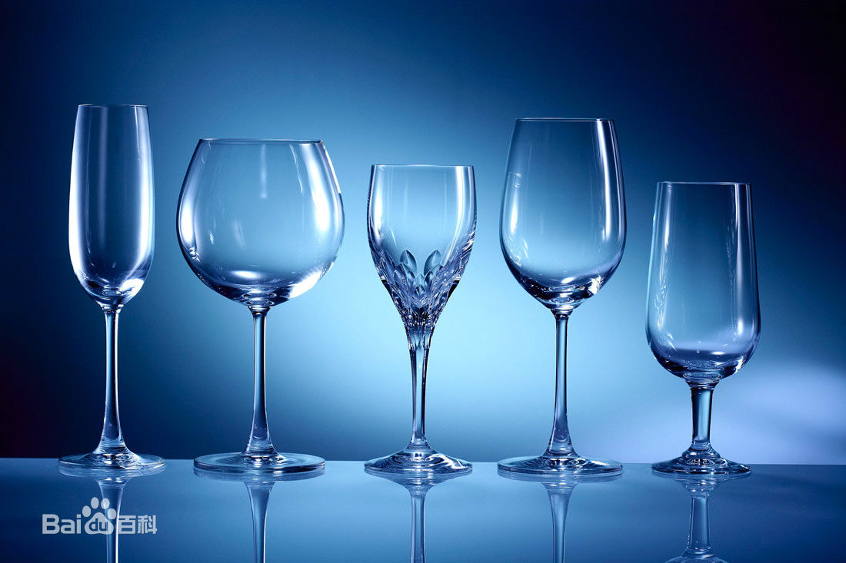
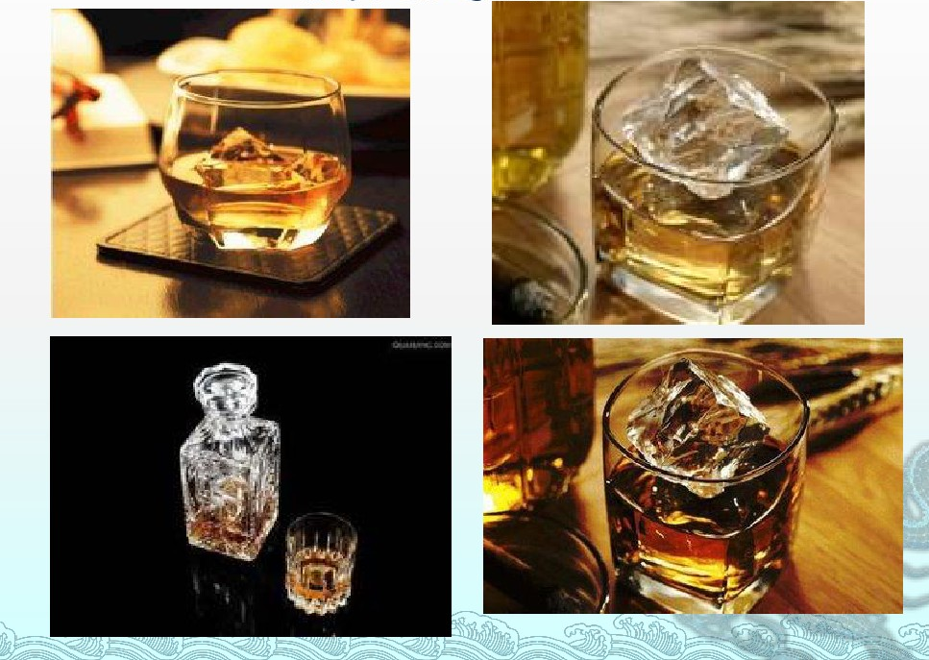
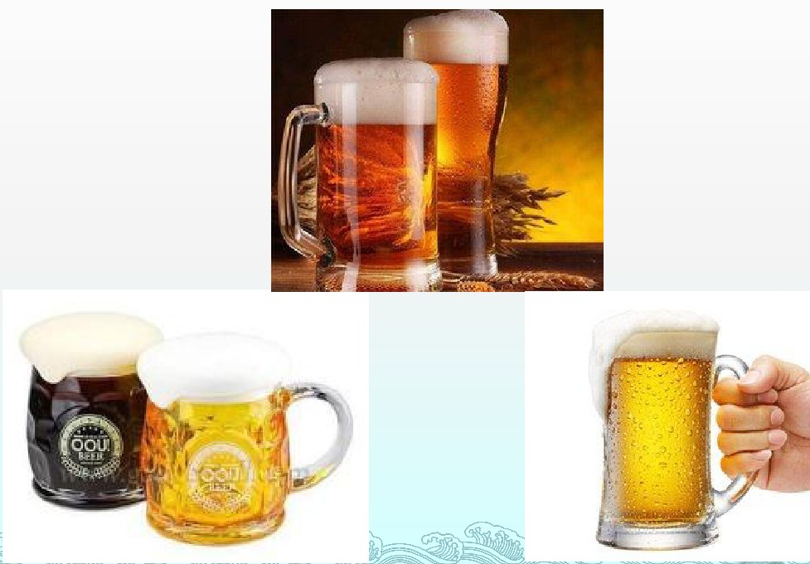
Cocktail(鸡尾酒)
Wine(红酒)
Whisky(威士忌酒)
Beer(啤酒)

